Slide 1
Hotel management system
Group members:
Aleeza Akhter
Kainat Jahangir
Syeda Fatima rehman

Slide 2
Table of content
Introduction
ER Model
Contributions
Queries

Slide 3
Introduction to hotel management system
A Hotel Management System Database is tailored to streamline the intricate operations involved in managing hotels, encompassing bookings, guest information, room allocations, billing, and reporting. This system serves as a comprehensive tool for hotels, resorts, and hospitality establishments to maintain meticulous records and enhance operational efficiency.

Slide 4
OBJECTIVES
Organization: Centralizing data pertaining to guests, rooms, reservations, and transactions for systematic management.
Efficiency: Facilitating swift and seamless handling of hotel operations, from check-ins to check-outs, to optimize staff productivity and guest satisfaction.
Accessibility: Ensuring easy accessibility to vital information, guaranteeing that pertinent details are readily available and consistently updated.
Decision Support: Providing insightful reports and analytics to aid in strategic decision-making, enhancing revenue management and service delivery.
Scalability: Adapting to the evolving needs of the establishment, accommodating increased volumes of data and expanding functionalities as the business grows.

Slide 5
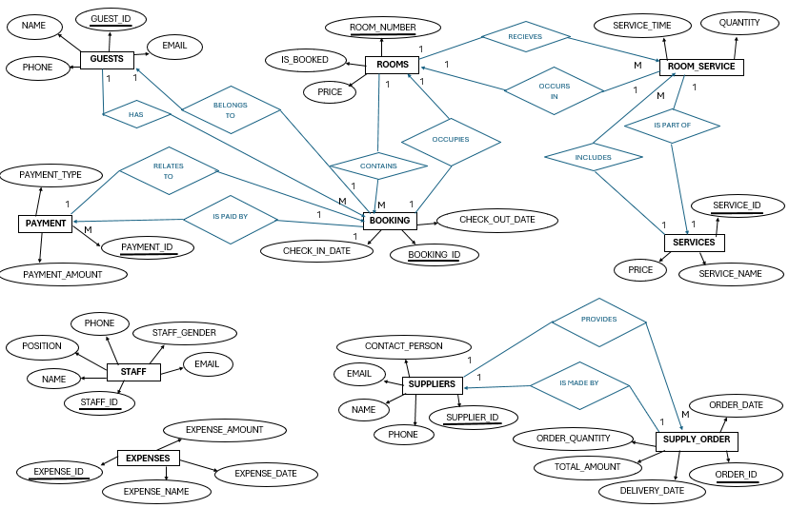
ER MODEL

Slide 6
contribution
KAINAT:
Created tables, inserted data in tables and wrote 10 queries.
FATIMA:
Made ER Model, helped in making tables and wrote 10 queries.
ALEEZA:
Wrote 30 queries.

Slide 7



QUERIES
Queries of Table : 1 (GUESTS)
SELECT * FROM Guests;
SELECT COUNT(*) AS total_guests FROM Guests;
SELECT name, email FROM Guests WHERE phone LIKE '123%';

Slide 8
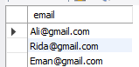

SELECT DISTINCT email FROM Guests;
SELECT name, email FROM Guests WHERE guest_id IN (SELECT guest_id FROM Bookings);

Slide 9


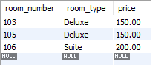
Queries of Table: 2 (ROOMS)
SELECT * FROM Rooms;
SELECT COUNT(*) AS booked_rooms FROM Rooms WHERE is_booked = TRUE;
SELECT room_number, room_type, price FROM Rooms WHERE price > 100;

Slide 10


SELECT DISTINCT room_type FROM Rooms;
Select room_number,room_type FROM Rooms Where is_booked=FALSE;

Slide 11



Queries of Table: 3 (BOOKINGS)
SELECT * FROM Bookings;
SELECT guest_id, COUNT(*) AS booking_count FROM Bookings GROUP BY guest_id;
SELECT * FROM Bookings WHERE check_out_date BETWEEN CURDATE() AND DATE_ADD(CURDATE(), INTERVAL 7 DAY);

Slide 12


SELECT * FROM Bookings WHERE DATEDIFF(check_out_date, check_in_date) > 3;
SELECT b.booking_id, g.name, r.room_number, r.room_type
FROM Bookings b
JOIN Guests g ON b.guest_id = g.guest_id
JOIN Rooms r ON b.room_number = r.room_number;

Slide 13



Queries of Table: 4 (STAFF)
SELECT * FROM Staff;
SELECT staff_gender, COUNT(*) AS total FROM Staff GROUP BY staff_gender HAVING COUNT(*) > 0;
SELECT name, position FROM Staff WHERE position = 'Manager';

Slide 14


SELECT DISTINCT position FROM Staff;
SELECT name, email FROM Staff WHERE email LIKE '%@gmail.com';

Slide 15



Queries of Table: 5 (SERVICES)
SELECT * FROM Services;
SELECT COUNT(*) AS total_services FROM Services;
SELECT service_name, price FROM Services WHERE price > 50;

Slide 16


SELECT DISTINCT service_name FROM Services;
SELECT service_name FROM Services WHERE service_id IN (SELECT service_id FROM Room_Service);

Slide 17



Queries of Table: 6 (ROOM_SERVICES)
SELECT * FROM Room_Service;
SELECT room_number, COUNT(*) AS service_count FROM Room_Service GROUP BY room_number;
SELECT * FROM Room_Service WHERE service_time > '10:00:00';

Slide 18


SELECT DISTINCT room_number FROM Room_Service;
SELECT rs.room_number, s.service_name, rs.quantity, rs.service_time FROM Room_Service rsJOIN Services s ON rs.service_id = s.service_id;

Slide 19



Queries of Table: 7 (PAYMENTS)
SELECT * FROM Payments;
SELECT payment_type, COUNT(*) AS payment_count FROM Payments GROUP BY payment_type;
SELECT * FROM Payments WHERE amount > 200;

Slide 20


SELECT DISTINCT payment_type FROM Payments;
SELECT p.payment_id, b.guest_id, b.room_number, p.amount, p.payment_type FROM Payments p JOIN Bookings b ON p.booking_id = b.booking_id;

Slide 21



Queries of Table: 8 (EXPENSES)
SELECT * FROM Expenses;
SELECT COUNT(*) AS total_expenses FROM Expenses;
SELECT * FROM Expenses WHERE amount > 100;

Slide 22

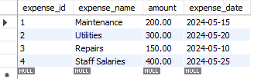
SELECT DISTINCT expense_name FROM Expenses;
SELECT * FROM Expenses WHERE expense_date BETWEEN DATE_SUB(CURDATE(), INTERVAL 1 MONTH) AND CURDATE();

Slide 23



Queries of Table: 9 (SUPPLIERS)
SELECT * FROM Suppliers;
SELECT COUNT(*) AS total_suppliers FROM Suppliers;
SELECT * FROM Suppliers WHERE contact_person LIKE 'A%';

Slide 24


SELECT DISTINCT name FROM Suppliers;
SELECT name, contact_person FROM Suppliers WHERE supplier_id IN (SELECT supplier_id FROM Supply_Orders);

Slide 25
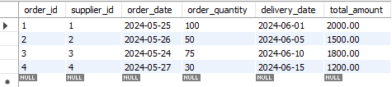

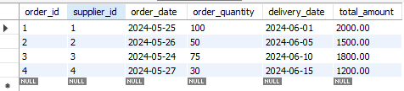
Queries of Table: 10 (SUPPLY_ORDERS)
SELECT * FROM Supply_Orders;
SELECT supplier_id, COUNT(*) AS order_count FROM Supply_Orders GROUP BY supplier_id;
SELECT * FROM Supply_Orders WHERE total_amount > 500;

Slide 26
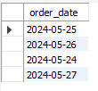
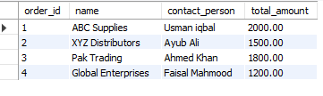
SELECT DISTINCT order_date FROM Supply_Orders;
SELECT so.order_id, s.name, s.contact_person, so.total_amount FROM Supply_Orders soJOIN Suppliers s ON so.supplier_id = s.supplier_id;

Slide 27

THANKYOU

